Slide 1
The Cochlear Implant Jackie Mitchell Visiting Teacher of the Deaf
Notes:
Into self and discuss pic. Pre covid – working on conversational language with a newly implanted student.

Slide 2
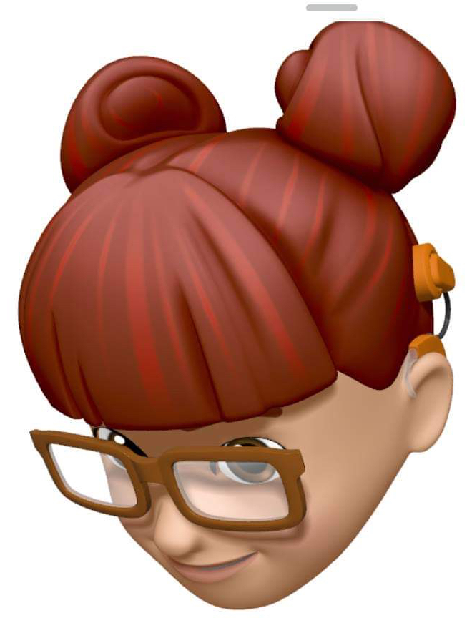
Today’s presentation will include:
Cochlear Implants
Trouble shooting
Learning to Listen
Notes:
We will look at the different implants that you might see in schools. There are other brands of implants but in Melbourne we usually see Cochlear brand as they were invented here.

Slide 3
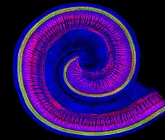
Sensorineural hearing loss
Caused by problems in the cochlear.
Notes:
People who have cochlear implants usually have a profound sensorineural hearing loss in the implanted ear.

Slide 4
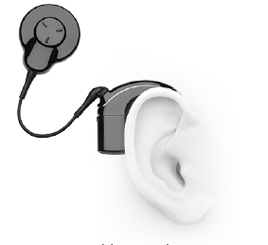
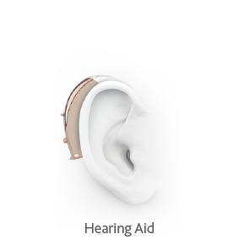
What is the difference between hearing aids and cochlear implants?
Hearing aids help many people by making the sounds they hear louder. Unfortunately, as hearing loss progresses, sounds need to not only be made louder, they need to be made clearer. Cochlear implants can help give you that clarity.
Notes:
Hearing aids increase the volume of the sound going into the ear. When there is a lot of damage to the cochlear the hearing aid is not adequate. There is not enough clarity. The cochlear implant can improve the clarity of the sound.

Slide 5
What does it sound like?
This is the million-dollar question!
It sounds different for each person.
Ask yourself – What does your hearing sound like?
Many people report that initially the sound is like Mickey Mouse or a robot. For other people they can only hear noises. Some people can understand speech straight away.
For most people it take time and work to understand speech.
Notes:
Everyone asks what does it sound like to have a cochlear implant. It changes as your brain adapts to the sound, especially if you haven’t heard anything in the implanted ear for a long time. The new implant is turned up gradually and is programmed regularly until the optimal sound input is achieved. It takes a lot of time and effort to achieve good results with an implant.

Slide 6
The cochlear implant
Cochlear Implants are mainly used for people who have little or no useable hearing. Their hearing cannot be amplified enough using a hearing aid.
They are now being use with children who have single sided deafness.
Cochlear Implants are very useful but have their limitations.
The Cochlear Implant doesn’t ‘fix’ the hearing.
Notes:
Who are you likely to see with an implant? They mostly used with people who are not achieving good results with a hearing aid. People who struggle to understand speech, even in the quiet. Some children with single sided deafness are being implanted.

Slide 7
Enemies of the cochlear implant
People who mumble
People who cover their mouths – with beards, hand, facemasks
Background noise
Faces in the shadows or darkness
People who speak from a distance
Notes:
The pandemic has made life very hard for people with hearing loss. Some voices are easier to hear than others. Accents, mumbling, covered mouths, background noise, inadequate lighting all make listening very difficult.

Slide 8
Listening fatigue
Listening through a cochlear implant is an ‘active’ process.
It takes a lot of brain power to understand speech.
By the end of the day many cochlear implant users are exhausted – just from listening.
Some people like to remove their devices to have a rest.
I like to watch a show with captioning to take a break from listening, or read a book or the newspaper.
Notes:
Listening through any listening device is very tiring. It’s a very active process and your brain has to constantly ‘fill in the gaps’ of what you have missed. You might find that your students are falling asleep in the afternoon.

Slide 9
Vocabulary
Switch on – usually takes place about 2 weeks after the operation.
Processor – the part worn behind the ear or on the magnet site (Kanso).
Coil – the part worn on the magnet site.
Mapping – programming of the implant.
Accessories – other devices that can be used with the implant.
CIC – Cochear Implant Clinic.
CCC – Cochlear Care Centre.
Unilateral – one ear.
Bilateral – two ears.

Slide 10
What does it cost?
The cost of CIs is covered by the government until the person reaches 26 years of age.
Some older people receive implants through Medicare – there is a waiting list and no guarantee of upgrades.
Most people use their private health insurance.
The cost of the processor is around $10,000.
Accessories cost more.
Some people are now receiving upgrades through the NDIS.

Slide 11
Nucleus 7
Smallest behind the ear processor.
Direct streaming from compatible devices.
Can be controlled by buttons, app or remote control.
Can be used with a Roger System via an adapter.
Notes:
There are a couple of different processors that you might find in schools. The most common one is the Nucleus 7.

Slide 12
Kanso 2
Released last year in Australia.
Smallest, lightest off the ear processor.
Rechargeable and can stream directly from devices.
Notes:
The Kanso 2 is an off the ear processor. It sits on the magnet site above the ear. It is rechargeable and can stream from devices. Some people love them. They are bulky on your head but have nothing behind the ear. It’s harder to wear hats and helmets so the audiologist would think about the lifestyle of the person before choosing a device.

Slide 13
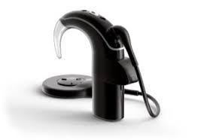
The cochlear implant in the classroom
The Mini Mic 2 connects with the Cochlear Implant
The iPad can stream straight to the Nucleus 7 or Kanso 2
The Roger Touchscreen can be used with a neckloop or with a Roger Receiver and an adapter
Notes:
The Cochlear Implant on it’s own is not sufficient for classroom learning. The distance from the speaker, background noise and reverberation all add up to a difficult listening environment. Luckily the CI can connect to other devices to enable to user to hear optimally. I have a mini mic which I use for yoga, pilates and cycling. It’s fantastic. In the classroom the Roger is often used and can be connected to the CI via an adapter.

Slide 14
Troubleshooting
Know your student!
Trust what they are telling you
Things do go wrong
Coil
Magnet
Cable
BATTERIES
Each student should have a spares kit! Vital for camps and excursions and every day at school.

Slide 15
OH NO!
You need to have a plan for what to do when things go wrong.
Does the child have an old speech processor that can be used as a spare? It needs to be reprogrammed every time the map is changed on the current processor.
Ensure that the ‘Spares Kit’ is up to date.
How are you going to communicate with the child if they are totally deaf?
Don’t presume that the child can read lips. Some deaf people are very good at this, and some can’t do it at all.

Slide 16
Batteries
The Nucleus 7 operates using either a rechargeable or 2 disposable batteries.
I use rechargeable batteries and swap them over every morning.
I also carry the disposable battery case so that I have a backup – just in case.
I would recommend that students do the same – the batteries are the big ‘blue’ batteries (675).

Slide 17
Swimming
The Cochlear Implant is ‘splash proof’ but not waterproof.
Families can purchase the Aqua + accessory for swimming.
You must use rechargeable batteries with the Aqua +.
It’s a bit tricky to use and I would suggest that you watch the video below before attempting to use it.
https://youtu.be/w2nRrpRZ1R8
Do not twist the coil! It looks as though it should be twisted but don’t do it.

Slide 18
Using a new implant
When a person (adult or child) is newly implanted they need to ‘train the brain’ to use the new sound supplied by the Cochlear Implant.
It can take a lot of time and effort to improve the student’s listening skills. Daily listening activities are vital to optimise the use of the implant. How can we fit this into our busy schedule?

Slide 19
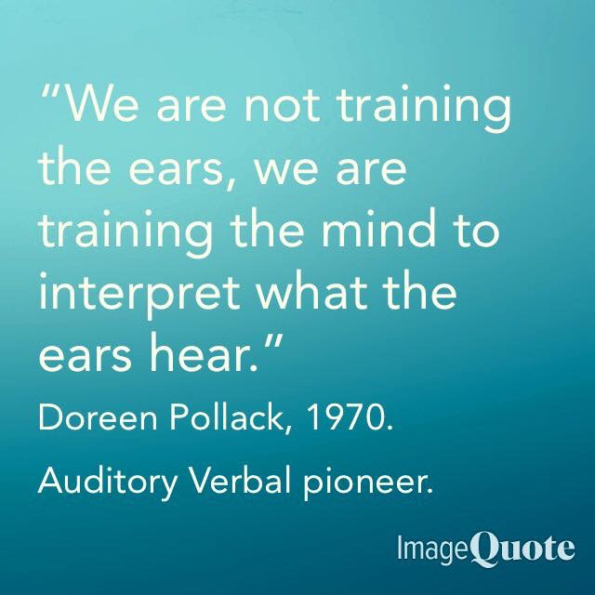

Slide 20
Word level listening
Given a list of familiar words (names, foods, etc) the listener listens to the word and identifies the correct word.
We begin with 3 very different words – peas, bananas, eggplant – and gradually increase the number of words and degree of difficulty.
As the listener progresses we work on minimal pairs – contrasting 2 words with two different sounds eg. shake and ship, then one different sound eg. sip and ship.

Slide 21
Sentence level listening
We begin with 3 very different sentences or phrases – Go home. I’m going to school now. We play netball at lunchtime every day.
We gradually increase the level of difficulty by making the phrases more similar and then more complex.
Games can be used such as ‘Go Fish’, ‘Guess Who?’ and any other games which involve questions. Think about the interests of the student and what they would enjoy doing.

Slide 22
Discourse level listening
We begin reading simple picture story books and have the listener try to match the words with the text.
This is very difficult initially but as the implant is mapped, and the sounds become clearer, it becomes easier.
When I initially received my implant I could only hear the vowel sounds, then gradually the high frequencies and finally the whole word (at approx. 6 weeks post switch on).
Audiobooks, Ted Talks, YouTube clips, TV shows – can all be used for Discourse level language activities – anything that engages the listener.

Slide 23
Brain Training
Learning to listen is quite different for children who are learning language compared to adult learners.
The process however is similar. It takes a lot of work.
During listening training ensure that the listener cannot see your mouth.
Sit beside the child (on the side that you are training) and make sure they look straight ahead.

Slide 24
The Issues
People think that I can hear normally – the implant has ‘fixed’ the hearing.
I still struggle in noisy situations, especially in a big group or where I can’t see people’s faces (camping).
Some rooms have very poor acoustics. Think about the acoustics in your school rooms. Science and cooking rooms, with hard surfaces and floors, make listening very difficult. Soften the surfaces as much as you can. Cushions, curtains, felt on tables - anything to reduce the noise ‘bouncing’ around.
The emotional issues of being deaf.

Slide 25
Social and Emotional Issues
This is a huge topic!
Everyone has their own feelings about this.
A person with a Cochlear Implant is still deaf. They are using technology to access sound. What happens when the technology doesn’t work? Expect the unexpected.
Some people feel that they are part of the ‘hearing’ world. They have nothing to do with Deaf people.
Some people feel that they are part of the ‘Deaf Community’ and learn to sign.
Some people belong to both communities.
Often the decision has been made for the child by the parents. Other issues can arise in regard to ‘deaf identity’ as the child becomes a teenager or young adult.

Slide 26
Any Questions?
© State of Victoria (Department of Education and Training) 2021
[Insert name of document] is provided under a Creative Commons Attribution 4.0 International licence. You are free to re-use the work under that licence, on the condition that you credit the State of Victoria (Department of Education and Training), indicate if changes were made and comply with the other licence terms, see: https://creativecommons.org/licenses/by/4.0/
The licence does not apply to: • any images, photographs, trademarks or branding, including the Victorian Government logo and the DET logo; and • content supplied by third parties.
Copyright queries may be directed to copyright@education.vic.gov.au

